Slide 1

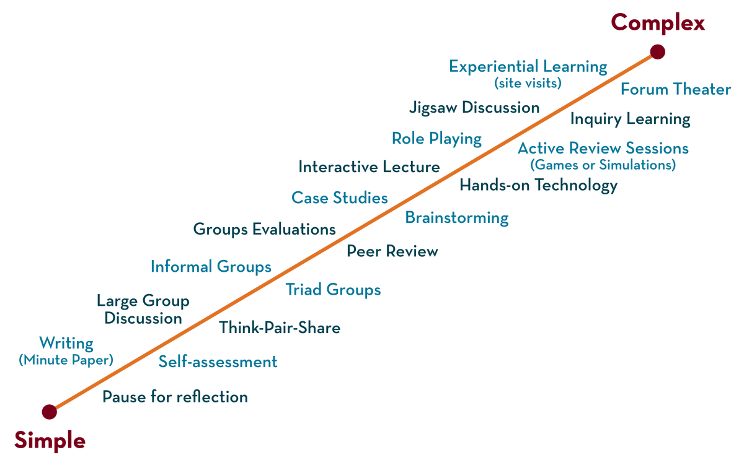
Department of CSE
Deep Learning
20CS3269AA
Topic:
Feed forward Neural Network
Session - 3

Slide 2
AIM OF THE SESSION
To familiarize students with the concept of Feed forward Neural Network
INSTRUCTIONAL OBJECTIVES
This Session is designed to:
Demonstrate the working of feed forward network
Solve back propogation of a neural network
LEARNING OUTCOMES
At the end of this session, you should be able to:
Able to solve neural network using back propogation

Slide 3
Index
Perceptron
Designing perceptron
Need of Feed forward Neural Network

Slide 4
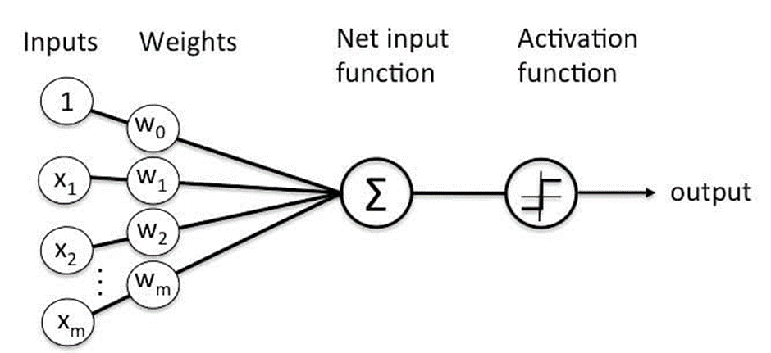
Perceptron
Perceptron was introduced by Frank Rosenblatt in 1957.
He proposed a Perceptron learning rule based on the original MCP neuron.
A Perceptron is an algorithm for supervised learning of binary classifiers.
This algorithm enables neurons to learn and processes elements in the training set one at a time.

Slide 5
Types of perceptron
Single layer:
Single layer perceptron can learn only linearly separable patterns
Multilayer:
Multilayer perceptron can learn about two or more layers having a greater processing power.

Slide 6

Perceptron function
Perceptron is a function that maps its input “x,” which is multiplied with the learned weight coefficient; an output value ”f(x)”is generated.
In the equation given above:
• “w” = vector of real-valued weights
• “b” = bias (an element that adjusts the boundary away from origin without any dependence on the input value)
• “x” = vector of input x values
• “m” = number of inputs to the Perceptron
The output can be represented as “1” or “0.”
It can also be represented as “1” or “-1” depending on which activation function is used.

Slide 7
Limitation of Perceptron Model
Limitation of a Perceptron model:
The output of a perceptron can only be a binary number (0 or 1) due to the hard-edge transfer function.
It can only be used to classify the linearly separable sets of input vectors. If the input vectors are non-linear, it is not easy to classify them correctly

Slide 8
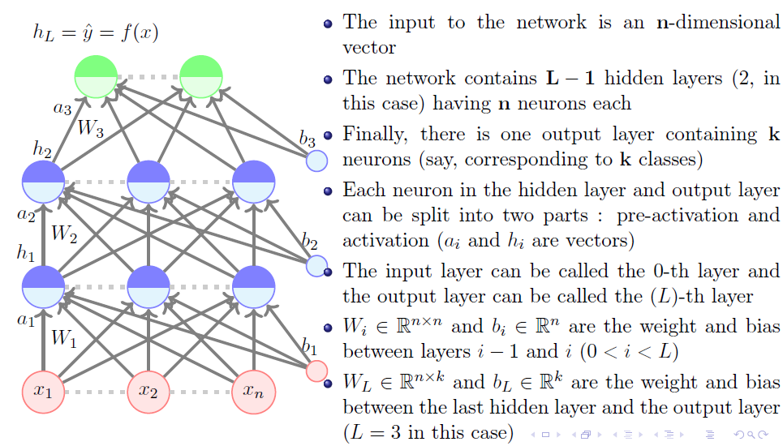
Feed Forward Neural Networks

Slide 9
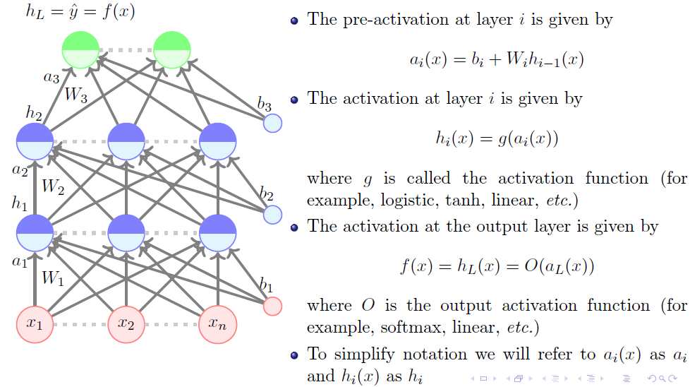
Feed Forward Neural Networks (Cont..)

Slide 10
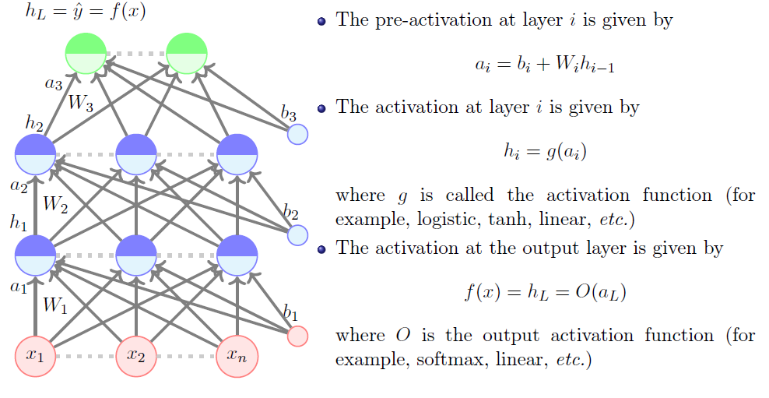
Feed Forward Neural Networks (Cont..)

Slide 11
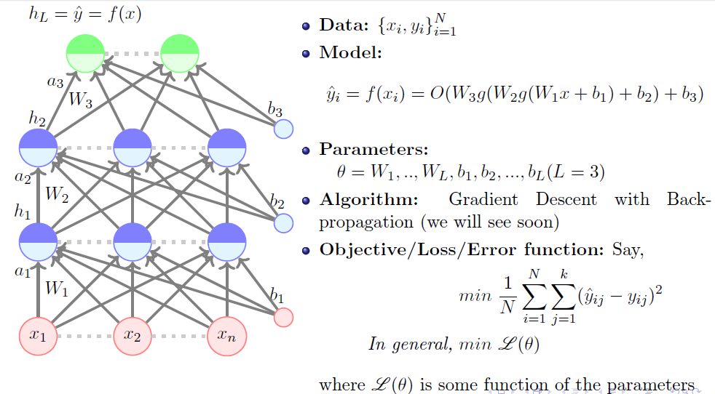
Feed Forward Neural Networks (Cont..)

Slide 12
SELF-ASSESSMENT QUESTIONS
What is the objective of backpropagation algorithm?
to develop learning algorithm for multilayer feedforward neural network
to develop learning algorithm for single layer feedforward neural network
to develop learning algorithm for multilayer feedforward neural network, so that network can be trained to capture the mapping implicitly
none of the
2. What are the general tasks that are performed with backpropagation algorithm?
pattern mapping
function approximation
prediction
all of the mentioned

Slide 13
TERMINAL QUESTIONS
1.Define Feedforward Neural Network
2.Demonstrate the Perceptron Learning Algorithm on the above data, using a learning rate of 1.0 and initial weight values of
w₀ = -1.5 w₁ = 0 w₂ = 2
In your answer, you should clearly indicate the new weight values at the end of each training step

Slide 14
REFERENCES FOR FURTHER LEARNING OF THE SESSION
Books:
1 Ian Goodfellow and Yoshua Bengio and Aaron Courville (2016) Deep Learning Book
Sites and Web links:
1.https://www.youtube.com/watch?v=X4RmokyD3U8&list=PLyqSpQzTE6M9gCgajvQbc68Hk_JKGBAYT&index=19
2. https://towardsdatascience.com/mcculloch-pitts-model-5fdf65ac5dd1
3. https://medium.datadriveninvestor.com/mp-neuron-and-perceptron-98abbd542e47

